Slide 1

Credit Card Fraud Detection
System
Infosys Springboard Internship 5.0 - AI
By:
Prarthana G Sri Lalitha B
Prem Raj P Ashvini Kumar
Shailesh KR Mansi Ranjan Gupta
Oleti Chandini

Slide 2

INTRODUCTION
Credit card fraud is a growing concern in the financial industry, causing billions of dollars in losses every year. As technology advances, so do the methods used by fraudsters to carry out unauthorized transactions. To address this challenge, a robust and efficient Credit Card Fraud Detection System becomes essential.
This system leverages machine learning algorithms to analyze transaction data, identify patterns, and detect suspicious activity in real time. By classifying transactions as either legitimate or fraudulent, the system helps protect cardholders and financial institutions from significant financial damage.

Slide 3
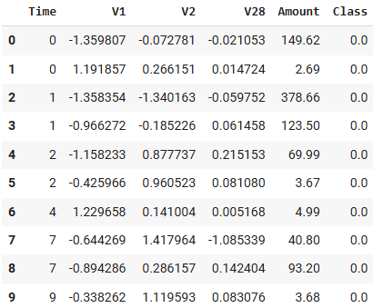
ABOUT THE DATASET
The dataset contains transactions made by credit cards in September 2013 by European cardholders. This dataset presents transactions that occurred in two days, where we have 492 frauds out of 284,807 transactions. The dataset is highly unbalanced, the positive class (frauds) account for 0.172% of all transactions.
Dataset Overview:
Source : Credit Card Fraud Detection - Kaggle
Size : 28487 rows x 31 columns
Total transactions: 284,807
Fraudulent transactions: 492

Slide 4
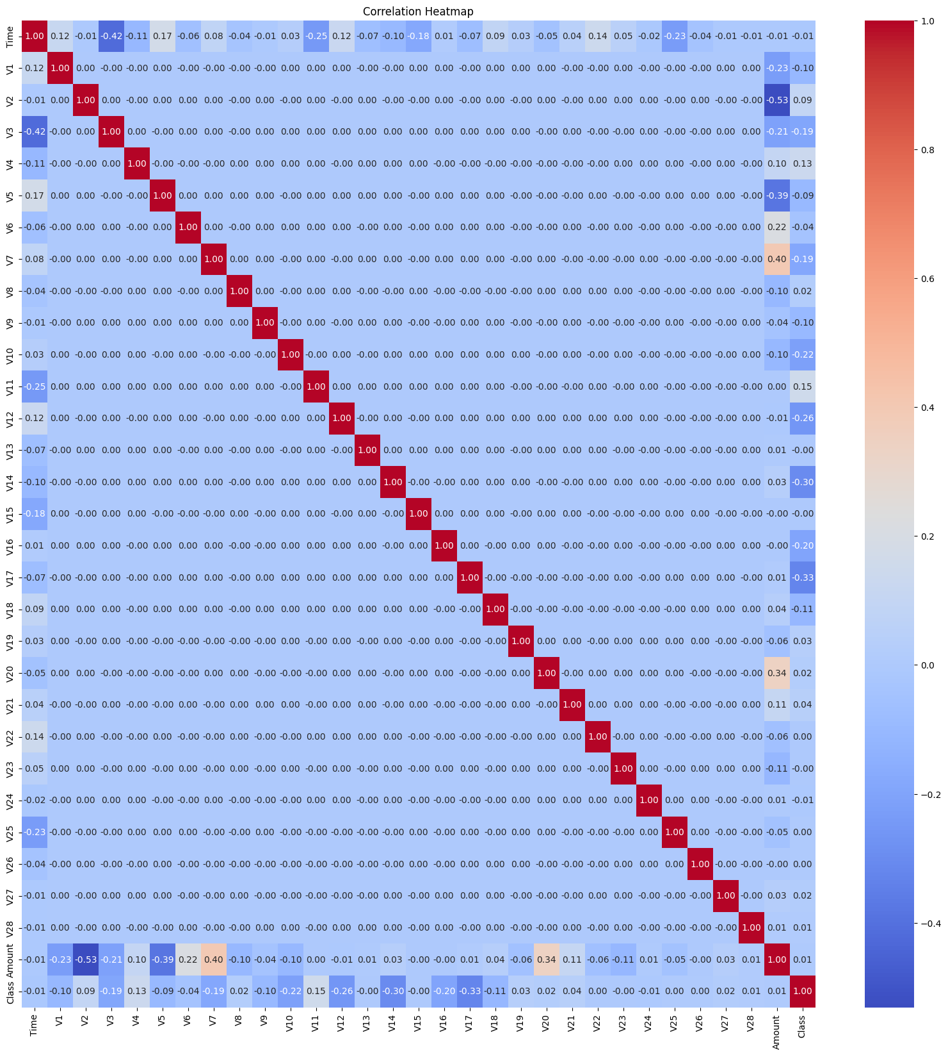
EXPLORATORY DATA ANALYSIS
We conducted EDA to gain key insights into the dataset:
Null Values:
Checked for missing values, and no null values were found, ensuring data quality for modeling.
Fraudulent Transactions Over Time:
Analyzed the occurrence of fraud over time, revealing specific time intervals with higher fraud activity.
Distribution of Time:
Explored transaction time distribution to identify any trends or unusual patterns across the dataset.
Class Distribution (0 = Non-Fraud, 1 = Fraud):
Observed a highly imbalanced dataset with fraudulent transactions comprising less than 1%, requiring techniques like oversampling or class weighting.
Correlation Heatmap:
Visualized feature correlations to identify strong predictors for fraud detection, guiding feature selection and engineering.

Slide 5
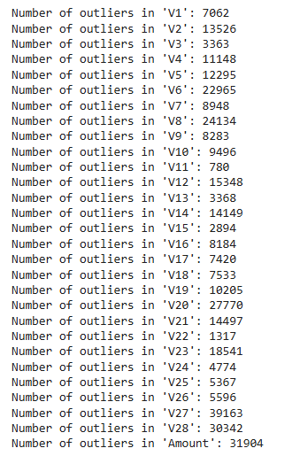
DATA PREPROCESSING
We conducted data preprocessing to improve model performance:
Handling Outliers using IQR:
Calculated Interquartile Range (IQR) for numerical columns.
Identified outliers where data points fall outside 1.5 * IQR from Q1 and Q3.
Counted outliers for each numerical column.
Scaling Numerical Data:
Applied RobustScaler to scale numerical features and handle outliers efficiently.
Handling Imbalanced Data with SMOTE:
SMOTE (Synthetic Minority Over-sampling Technique) was used to balance the class distribution in the dataset by generating synthetic samples.
Split data into training and testing sets (80% training, 20% testing) with stratified sampling to maintain class balance.

Slide 6
MODEL SELECTION
We deployed seven machine learning models to detect fraudulent credit card transactions effectively:
Logistic Regression
Decision Tree
Random Forest
LightGBM
XGBoost
CatBoost
SVM (Support Vector Machine)

Slide 7
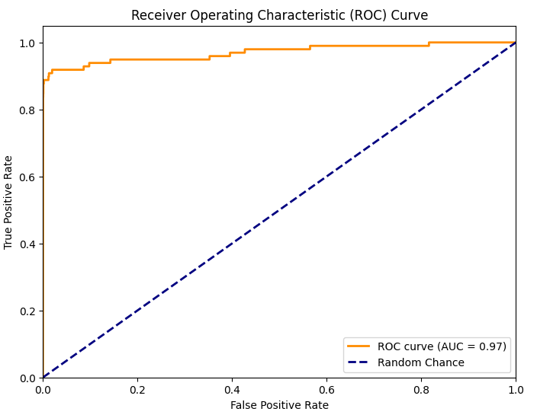
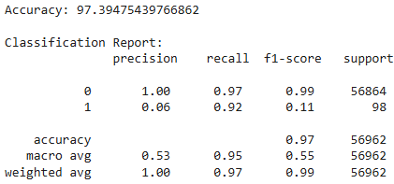
1. LOGISTIC REGRESSION
Logistic Regression: A statistical model used for binary classification, predicting probabilities using a sigmoid function.

Slide 8
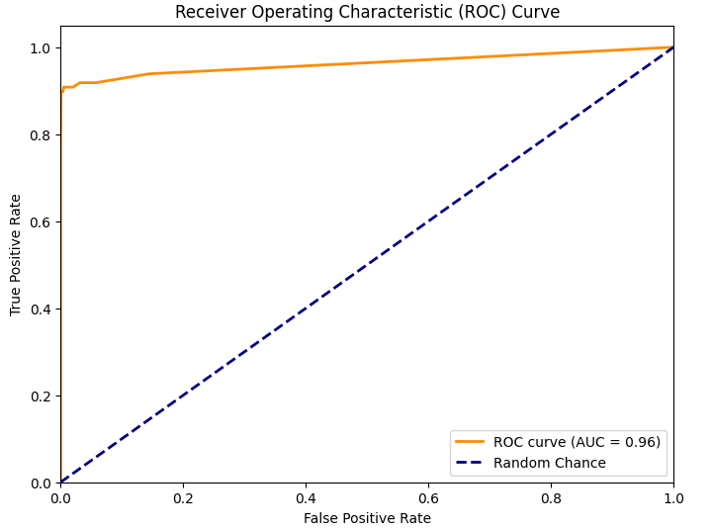
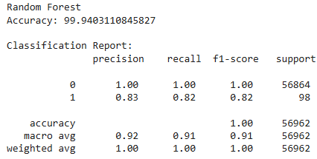
2. RANDOM FOREST
Random Forest: An ensemble of decision trees that improves accuracy by averaging predictions and reducing overfitting.

Slide 9
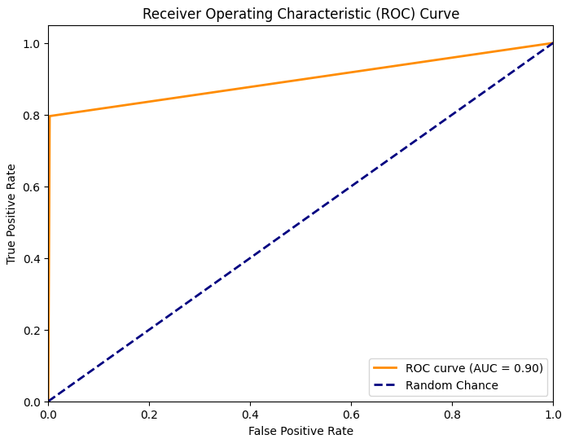
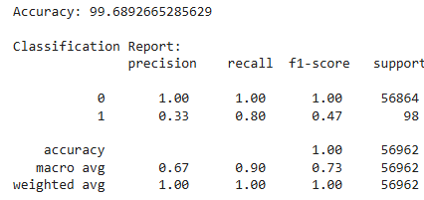
3. DECISION TREE
Decision Tree: A tree-like model for decision-making, splitting data based on feature thresholds to predict outcomes.

Slide 10
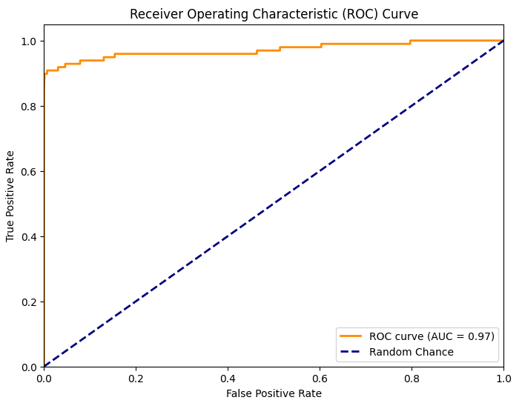
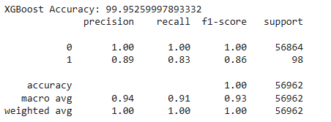
4. XGBOOST
XGBoost: An efficient gradient boosting algorithm designed for speed and performance, leveraging advanced regularization techniques

Slide 11
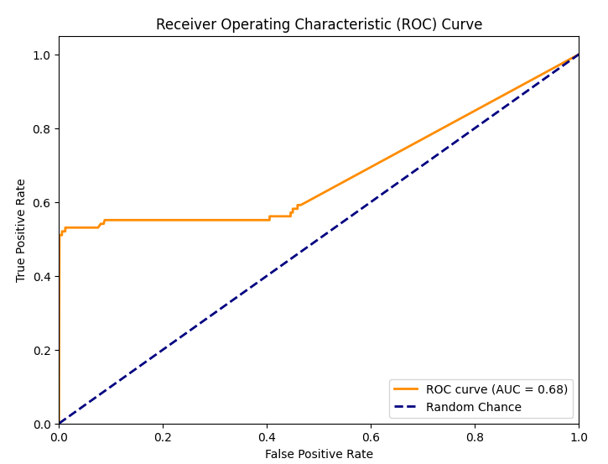
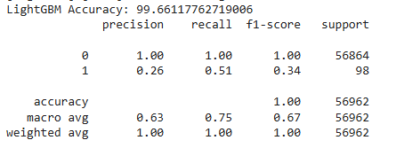
5. LIGHTGBM
LightGBM: A gradient boosting framework that uses decision tree algorithms and is optimized for speed and memory efficiency.

Slide 12
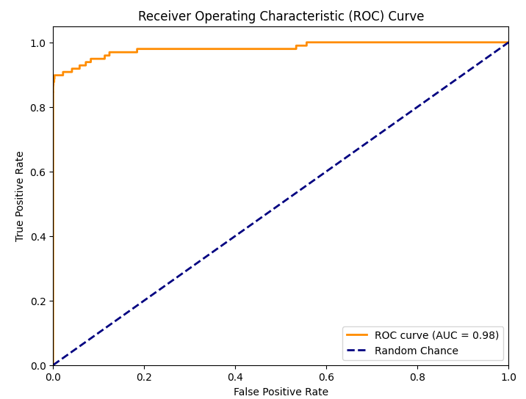
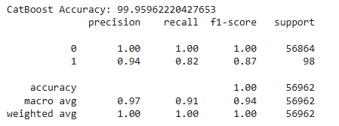
6. CATBOOST
CatBoost: A powerful gradient boosting algorithm optimized for handling categorical data efficiently and achieving high accuracy.

Slide 13
7. SUPPORT VECTOR MACHINE
SVM (Support Vector Machine): A supervised learning algorithm that finds the optimal hyperplane to separate data into classes.

Slide 14
MODEL SUMMARY
Model | Accuracy | Precision | Recall | f1-Score | ROC Score
Logistic Regression | 97.39 | 0.06 | 0.92 | 0.11 | 0.97
Random Forest | 99.94 | 0.83 | 0.82 | 0.82 | 0.96
Decision Tree | 99.68 | 0.33 | 0.80 | 0.47 | 0.90
XGBoost | 99.95 | 0.89 | 0.83 | 0.86 | 0.97
LightGBM | 99.66 | 0.26 | 0.51 | 0.34 | 0.68
CatBoost | 99.95 | 0.94 | 0.81 | 0.87 | 0.98
Support Vector Machine | 99.94 | 0.94 | 0.69 | 0.80 | 0.97

Slide 15
CONCLUSION
After evaluating multiple models—Logistic Regression, Random Forest, XGBoost, Decision Tree, and LightGBM—on a highly imbalanced dataset, the following insights were drawn:
Best Overall Model is the CatBoost model. It consistently outperformed the others in handling the class imbalance. It achieved:
Accuracy: 99.96%
Precision (Class 1): 94%
Recall (Class 1): 81%
F1-Score (Class 1): 87%

Slide 16
THANK YOU

